Slide 1
Test Automation & Advanced Selenium
Lesson 7: Selenium Web Driver – Advance

Slide 2
Lesson Objectives
Selenium: How it works
Different drivers
Chrome
Firefox
Internet Explorer
Headless Browser
Ghost Driver and Phantom JS
Mobile Browsers
Selendriod & Appium
Remote Web Driver
Capabilities
Profile setting
Selenium Grid

Slide 3







7.1: Selenium Web Driver – Advance Selenium - How it works?
Bindings
Selenium
WebDriver API
Drivers
Java
Firefox
Safari
Ruby
Chrome
Browsers
Python
IE
C#
Opera
Others
Others

Slide 4
7.1: Selenium Web Driver – Advance Different Drivers
Firefox:
WebDriver driver = new FirefoxDriver();
IE:
WebDriver driver = new InternetExplorerDriver();
Chrome:
WebDriver driver = new ChromeDriver();
Safari:
WebDriver driver = new SafariDriver();
Opera:
WebDriver driver = new OperaDriver()
GhostDriver and PhantomJs:
WebDriver driver = new PhantomJSDriver()
Notes:
1. Architecture
WebDriver's architecture is simpler than Selenium RC's.
It controls the browser from the OS level
All you need are your programming language's IDE (which contains your Selenium commands) and a browser.
You first need to launch a separate application called Selenium Remote Control (RC) Server before you can start testing
The Selenium RC Server acts as a "middleman" between your Selenium commands and your browser
When you begin testing, Selenium RC Server "injects" a Javascript program called Selenium Core into the browser.
Once injected, Selenium Core will start receiving instructions relayed by the RC Server from your test program.
When the instructions are received, Selenium Core will execute them as Javascript commands.
The browser will obey the instructions of Selenium Core, and will relay its response to the RC Server.
The RC Server will receive the response of the browser and then display the results to you.
RC Server will fetch the next instruction from your test script to repeat the whole cycle.

Slide 5
Notes:
2. Speed
WebDriver is faster than Selenium RC since it speaks directly to the browser uses the browser's own engine to control it.
Selenium RC is slower since it uses a Javascript program called Selenium Core. This Selenium Core is the one that directly controls the browser, not you.
3. Real-life Interaction
WebDriver interacts with page elements in a more realistic way. For example, if you have a disabled text box on a page you were testing, WebDriver really cannot enter any value in it just as how a real person cannot.
Selenium Core, just like other Javascript codes, can access disabled elements. In the past, Selenium testers complain that Selenium Core was able to enter values to a disabled text box in their tests. Differences in API
4. API
Selenium RC's API is more matured but contains redundancies and often confusing commands.
For example, most of the time, testers are confused whether to use type or typeKeys; or whether to use click, mouseDown, or mouseDownAt. Worse, different browsers interpret each of these commands in different ways tool
WebDriver's API is simpler than Selenium RC's. It does not contain redundant and confusing commands.
5. Browser Support
WebDriver can support the headless HtmlUnit browser
HtmlUnit is termed as "headless" because it is an invisible browser - it is GUI-less.
It is a very fast browser because no time is spent in waiting for page elements to load. This accelerates your test execution cycles.
Since it is invisible to the user, it can only be controlled through automated means.
Selenium RC cannot support the headless HtmlUnit browser. It needs a real, visible browser to operate on.

Slide 6

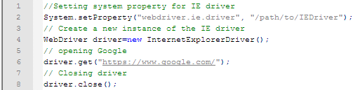
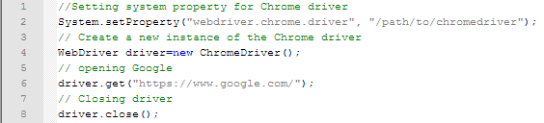
7.1: Selenium Web Driver – Advance Different Drivers (Cont.)
Firefox Driver:
IE Driver:
Chrome Driver:
Notes:
1. Architecture
WebDriver's architecture is simpler than Selenium RC's.
It controls the browser from the OS level
All you need are your programming language's IDE (which contains your Selenium commands) and a browser.
You first need to launch a separate application called Selenium Remote Control (RC) Server before you can start testing
The Selenium RC Server acts as a "middleman" between your Selenium commands and your browser
When you begin testing, Selenium RC Server "injects" a Javascript program called Selenium Core into the browser.
Once injected, Selenium Core will start receiving instructions relayed by the RC Server from your test program.
When the instructions are received, Selenium Core will execute them as Javascript commands.
The browser will obey the instructions of Selenium Core, and will relay its response to the RC Server.
The RC Server will receive the response of the browser and then display the results to you.
RC Server will fetch the next instruction from your test script to repeat the whole cycle.

Slide 7
Notes:
2. Speed
WebDriver is faster than Selenium RC since it speaks directly to the browser uses the browser's own engine to control it.
Selenium RC is slower since it uses a Javascript program called Selenium Core. This Selenium Core is the one that directly controls the browser, not you.
3. Real-life Interaction
WebDriver interacts with page elements in a more realistic way. For example, if you have a disabled text box on a page you were testing, WebDriver really cannot enter any value in it just as how a real person cannot.
Selenium Core, just like other Javascript codes, can access disabled elements. In the past, Selenium testers complain that Selenium Core was able to enter values to a disabled text box in their tests. Differences in API
4. API
Selenium RC's API is more matured but contains redundancies and often confusing commands.
For example, most of the time, testers are confused whether to use type or typeKeys; or whether to use click, mouseDown, or mouseDownAt. Worse, different browsers interpret each of these commands in different ways tool
WebDriver's API is simpler than Selenium RC's. It does not contain redundant and confusing commands.
5. Browser Support
WebDriver can support the headless HtmlUnit browser
HtmlUnit is termed as "headless" because it is an invisible browser - it is GUI-less.
It is a very fast browser because no time is spent in waiting for page elements to load. This accelerates your test execution cycles.
Since it is invisible to the user, it can only be controlled through automated means.
Selenium RC cannot support the headless HtmlUnit browser. It needs a real, visible browser to operate on.

Slide 8
7.1: Selenium Web Driver – Advance Different Drivers (Cont.)
Headless Browser
Web browser without a graphical user interface
Normally, interaction with a website are done with mouse and keyboard using a browser with a GUI
While most headless browser provides an API to manipulate the page/DOM, download resources etc.
So instead of, for example, actually clicking an element with the mouse, a headless browser allows you to click an element by code
Headers, Local storage and Cookies work the same way
List of Headless Browsers
PhanthomJS
HtmlUnit
TrifleJS
Splash
Notes:
Headless browsers are typically used in following situations:
1. You have a central build tool which does not have any browser installed on it. So to do the basic level of sanity tests after every build you may use the headless browser to run your tests.
2. You want to write a crawler program that goes through different pages and collects data, headless browser will be your choice. Because you really don’t care about opening a browser. All you need is to access the webpages.
3. You would like to simulate multiple browser versions on the same machine. In that case you would want to use a headless browser, because most of them support simulation of different versions of browsers. We will come to this point soon.
Things to pay attention to before using headless browser
Headless browsers are simulation programs, they are not your real browsers. Most of these headless browsers have evolved enough to simulate, to a pretty close approximation, like a real browser. Still you would not want to run all your tests in a headless browser. JavaScript is one area where you would want to be really careful before using a Headless browser. JavaScript are implemented differently by different browsers. Although JavaScript is a standard but each browser has its own little differences in the way that they have implemented JavaScript. This is also true in case of headless browsers also. For example HtmlUnit headless browser uses the Rihno JavaScript engine which not being used by any other browser.
Selenium support for headless browser
Selenium supports headless testing using its class called HtmlUnitDriver. This class internally uses HtmlUnit headless browser. HtmlUnit is a pure Java implementation. HtmlUnitWebDriver can be created as mentioned below:
HtmlUnitDriver unitDriver = new HtmlUnitDriver();

Slide 9
7.1: Selenium Web Driver – Advance Different Drivers (Cont.)
PhanthomJS (Headless Browser)
HEADLESS WEBSITE TESTING
Headless Web Kit with JavaScript API
SCREEN CAPTURE
Programmatically capture web contents, including SVG and Canvas
PAGE AUTOMATION
Access and manipulate webpages with the standard DOM API, or with usual libraries like jQuery
Example of interacting with a page using PhantomJS:
page.evaluate(function() {
//Fill in form on page
document.getElementById('Name').value = 'John Doe';
document.getElementById('Email').value = 'john.doe@john.doe';
//Submit
$('#SubmitButton').click();
});

Slide 10
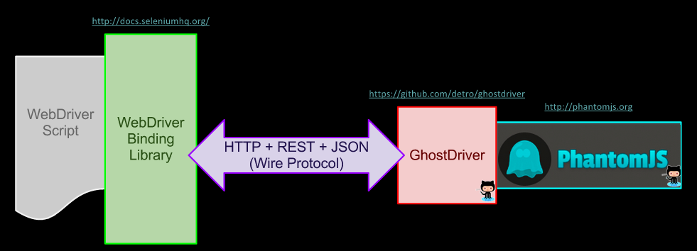
7.1: Selenium Web Driver – Advance Different Drivers (Cont.)
GhostDriver(Headless Browser)
Pure JavaScript implementation of the WebDriver Wire Protocol for PhantomJS Remote
WebDriver that uses PhantomJS as back-end
Notes:
GhostDriver is the project that provides the code that exposes the WebDriver API for use within PhantomJS.
PhantomJS bakes the GhostDriver code into itself, and ships it as part of its downloadable executable.
Thus, to use "GhostDriver" with PhantomJS, only PhantomJS is needed.

Slide 11
7.1: Selenium Web Driver – Advance Different Drivers (Cont.)
Mobile Browsers
Mobile web browsers differ greatly in terms of features offered an operating systems supported
Best can display most websites and offer page zoom and keyboard shortcuts, while others can only display websites optimizes for mobile devices
Appium and Selendroid are the two cross browser mobile automation tool
Appium(Mobile Browser)
Open-source tool for automating native, mobile web, and hybrid applications on iOS and Android platforms, which is handled by a Appium node.js server.
Cross-platform which allows to write tests against multiple platforms (iOS, Android), using the same API
Enables code reuse between iOS and Android test suites
Notes:
Native apps are those written using the iOS or Android SDKs.
Mobile web apps are web apps accessed using a mobile browser (Appium supports Safari on iOS and Chrome or the built-in 'Browser' app on Android). Hybrid apps have a wrapper around a "webview" -- a native control that enables interaction with web content. Projects like Phonegap, make it easy to build apps using web technologies that are then bundled into a native wrapper, creating a hybrid app.
Appium was designed to meet mobile automation needs according to a philosophy outlined by the following four tenets:
You shouldn't have to recompile your app or modify it in any way in order to automate it.
You shouldn't be locked into a specific language or framework to write and run your tests.
A mobile automation framework shouldn't reinvent the wheel when it comes to automation APIs.
A mobile automation framework should be open source, in spirit and practice as well as in name.

Slide 12
7.1: Selenium Web Driver – Advance Different Drivers (Cont.)
Selendroid
Test automation framework which is used Android native & hybrid applications (apps) and mobile web
Full compatibility with the JSON Wire Protocol
No modification of app under test required in order to automate it
Testing the mobile web using built in Android driver webview app
UI elements can be found by different locator types
Selendroid can interact with multiple Android devices (emulators or hardware devices) at the same time
Existing emulators are started automatically
Supports hot plugging of hardware devices
Full integration as a node into Selenium Grid for scaling and parallel testing

Slide 13
7.1: Selenium Web Driver – Advance Remote Web Driver
Implementation class of the WebDriver interface that a test script developer can use to execute their test scripts via the Remote WebDriver server on a remote machine
Needs to be configured so that it can run your tests on a separate machine
If driver is not Remote WebDriver, communication to the web browser is local. So driver will be used as below: Webdriver driver = new FirefoxDriver(); using driver will access Firefox on the local machine, directly
If Remote WebDriver, needs location Selenium Server (Grid) web browser
For example, WebDriver driver = new RemoteWebDriver(new URL("http://localhost:4444/wd/hub"), DesiredCapabilities.firefox());
Notes:
This example assumes that Selenium Server is running on localhost with the default port of 4444. The nice thing about this is you can run Selenium Server on any machine, change the URL to point to the new machine and run the tests. For example, I run the test code from my Mac OS X computer but I run Selenium Server on a Window XP machine. This way I can launch Internet Explorer tests from my Mac OS X computer.

Slide 14
7.1: Selenium Web Driver – Advance Capabilities and Profile Setting
Capabilities describes a series of key/value pairs that encapsulate aspects of a browser
DesiredCapabilities set properties for the WebDriver
Profile used to create custom Firefox profile and use it with desired capabilities
Example to use Firefox profile with desired capabilities:
DesiredCapabilities dc=DesiredCapabilities.firefox();
FirefoxProfile profile = new FirefoxProfile();
dc.setCapability(FirefoxDriver.PROFILE, profile);
Webdriver driver = new FirefoxDriver(dc);

Slide 15
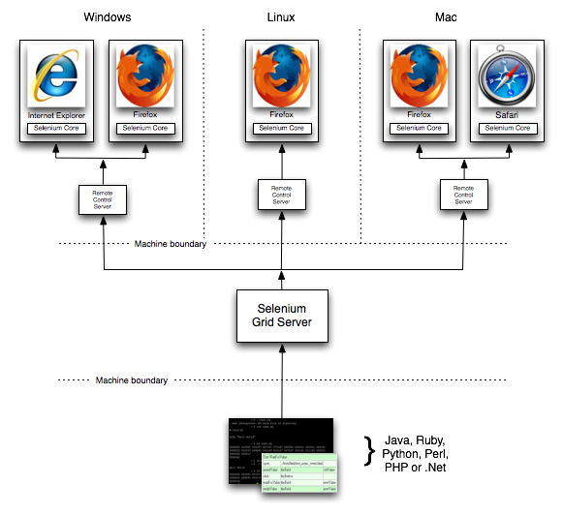
7.1: Selenium Web Driver – Advance Selenium Grid
Allows you run your tests on different machines against different browsers in parallel. That is, running multiple tests at the same time against different machines running different browsers and operating systems. Essentially, Selenium-Grid support distributed test execution. It allows for running your tests in a distributed test execution environment.

Slide 16
Summary
In this lesson, you have learnt
In this lesson, you have understood that how the selenium works and interacts with client server.
Different drivers that are available for selenium-Chrome , IE ,Firefox ,headless browsers and mobile browsers.
In remote webdriver the server will always run on the machine with the browser you want to test. And ,there are two ways to user the server: command line or configured in code.
Capabilities gives facility to set the properties of browser. Such as to set BrowserName, Platform, Version of Browser.
There are two reasons why you might want to use Selenium-Grid.
To run your tests against multiple browsers, multiple versions of browser, and browsers running on different operating systems.
To reduce the time it takes for the test suite to complete a test pass.
Notes:
Add the notes here.

Slide 17
Review Question
Question 1:
PhanthomJS is
Chrome Driver
Mobile Browser
Headless Browser
Firefox Driver
Question 2: True/False
Firefox saves your information such as cookies and browser history in a file called your profile.
Question 3: Fill in the Blanks
Client driver will send the program that is written in eclipse IDE as ________ and send it to Selenium server

